Slide 1
Data PreProcessing & Feature Engineering

Slide 2

HELLO!
I am Arpit Jain
I am here because Data Science is my passion and I love sharing my expertise with people.

Slide 3
Agenda
1
Introduction to Data Preprocessing
Missing Value Analysis
Outlier Analysis
Data Nornalization & Encoding
Feature Engineering

Slide 4
Data Pre Processing
Data preprocessing is a crucial step in the data science pipeline that involves cleaning, transforming, and organizing raw data into a format suitable for analysis. It lays the foundation for accurate and meaningful insights from data.
Varied usages.
Helps getting the true and useful data for better analysis and thus helping business.

Slide 5
Data Pre Processing
Missing Data Handling
Noise Reduction
Data Consistency
Outliers Detection
Categorical Data Handeling
Feature Scaling

Slide 6
Missing Value Analysis
Missing value analysis, also known as missing data analysis, is a crucial step in data preprocessing
It involves identifying, understanding, and handling missing values in a dataset. Missing values are data points that are not recorded or available for certain variables in a dataset.
They can occur for various reasons, such as data entry errors, equipment failures, or respondents choosing not to answer certain questions in surveys.
It's essential to address missing values appropriately because they can impact the quality and validity of data analysis and modeling.

Slide 7
Missing Value Analysis
Identifying the Missing Data
Begin by identifying missing values in your dataset. These missing values may be represented as NaN (Not a Number), NULL, or other placeholders depending on the data format.
Even 0 values could be a hint of missing data.
Use tools like data visualization, summary statistics, or programming libraries like Pandas in Python to identify missing values in your dataset.

Slide 8
Missing Value Analysis
Treating the Missing Data
Mean, median, and mode imputation
Domain-specific imputation methods
Predictive imputation methods

Slide 9
Outlier Analysis
Outlier analysis, also known as outlier detection or outlier handling, is a crucial step in data preprocessing.
It involves identifying and managing outliers in a dataset. Outliers are data points that significantly deviate from the majority of the data and can distort statistical analysis, modeling, and data visualization.
Outlier analysis aims to detect these anomalies and decide how to handle them.

Slide 10
Outlier Analysis
Identifying the Outlier Data
1. Visualizations:
Box Plots: Use box plots to identify outliers. Outliers are typically represented as points outside the whiskers (lines extending from the box) of the box plot.
Scatter Plots: In scatter plots, look for data points that are far from the general pattern or trend of the data. These points can be considered outliers.
Histograms: In histograms, identify bins with very few or no data points. Data points falling in these bins may be outliers.

Slide 11
Outlier Analysis
Identifying the Outlier Data
2. Statistical Methods:
Z-Score: Calculate the Z-score for each data point. Z-score measures how many standard deviations a data point is from the mean. Data points with a high absolute Z-score (typically > 3 or < -3) are considered outliers.
IQR (Interquartile Range): Calculate the IQR, which is the range between the 75th percentile (Q3) and the 25th percentile (Q1). Any data point below Q1 - 1.5 * IQR or above Q3 + 1.5 * IQR is considered an outlier.

Slide 12
Outlier Analysis
Identifying the Outlier Data
2. Statistical Methods:
Z-Score: Calculate the Z-score for each data point. Z-score measures how many standard deviations a data point is from the mean. Data points with a high absolute Z-score (typically > 3 or < -3) are considered outliers.
IQR (Interquartile Range): Calculate the IQR, which is the range between the 75th percentile (Q3) and the 25th percentile (Q1). Any data point below Q1 - 1.5 * IQR or above Q3 + 1.5 * IQR is considered an outlier.

Slide 13
Outlier Analysis
Identifying the Outlier Data
3. Predcitive Methods:
Isolation Forest: Tree based approach which identifies values which are few and values which are different from normal values.
DBSCAN: Clustering based approach which separates the high-density regions of the data from the low-density areas.

Slide 14
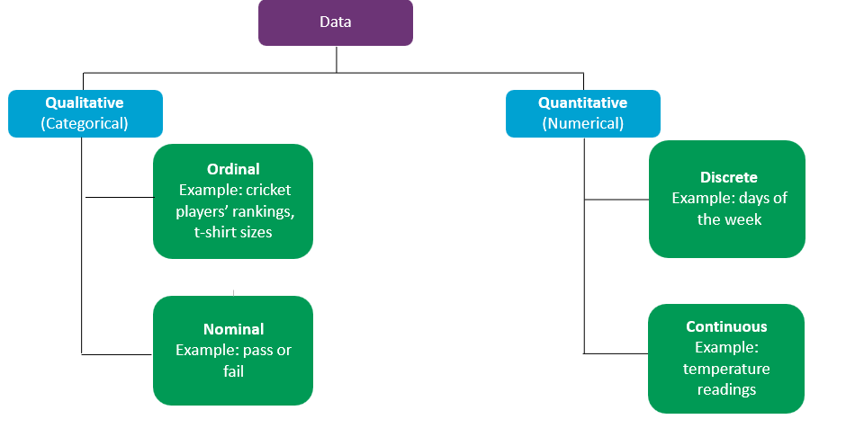
Type Of Data

Slide 15
Data Normalization
Data normalization is a preprocessing technique used in data science to scale and transform data into a common range or format.
The goal of data normalization is to ensure that different features or variables in the dataset have similar scales and distributions, making it easier for machine learning algorithms to process the data effectively.

Slide 16
Data Normalization Techniques
Min Max Scaling: Min-max scaling, also known as min-max normalization, is a data preprocessing technique used to scale and transform numerical data into a specific range, typically between 0 and 1.
Scaled_x = (x - min_val) / (max_val - min_val)
Standard Scaling: Standard scaling, also known as Z-score normalization or Z-score standardization, is a data preprocessing technique used to transform numerical data in such a way that it has a mean (average) of 0 and a standard deviation of 1.
Standardized_x = (x - μ) / σ

Slide 17
Encoding
Encoding in data preprocessing refers to the process of converting categorical or textual data into a numerical format that can be used for analysis or by machine learning algorithms.
Categorical data represents discrete categories or labels, such as color names or product categories, and cannot be directly used in mathematical models.
Encoding is essential because many machine learning algorithms and statistical techniques require numerical inputs, and converting categorical data to numerical form makes it compatible with these methods.

Slide 18
Encoding Techniques
Label Encoding: Assigns a unique integer label to each category in a categorical variable. This method is suitable for ordinal data, where the order of categories matters.
One-Hot Encoding: Creates binary columns for each category in the variable. Each category gets a column, and a "1" is placed in the corresponding column for the category present in the original data, while others receive "0"s. This method is suitable for nominal data, where there is no inherent order among categories.

Slide 19
Feature Engineering
It involves creating new features (variables) or transforming existing ones to enhance the performance of machine learning models, improve data visualization, and extract more meaningful information from the data.
Feature engineering plays a crucial role in shaping the quality and effectiveness of predictive models.
Converting categorical data into a numerical format is essential. Extracting relevant information from complex or unstructured data types, such as text, images, or time series, to create structured features that can be used in modeling.
Getting Age from DOB columns, generating polynomial features etc could be another example.

Slide 20

Thank You

